Slide 1
TITLE: sentimental analysis
CAPSTONE PROJECT:ARTIFICAL INTELEGENCE
AND MACHINE LEARNING
Presented By:
Name:Nakka Anantha Lakshmi
College Name:Aditya College Of Engineering
Department: Computer Science and Engineering

Slide 2
OUTLINE:
Problem Statement (Should not include solution)
Proposed System/Solution
System Development Approach (Technology Used)
Algorithm & Deployment
Result
Conclusion
Future Scope
References

Slide 3
PROBLEM STAMENT:
I perfomed a task on sentiment analysis on restaurant reviews.
Sentiment analysis involves determining the sentiment expressed in a piece of text, typically categorizing it as positive, negative, or neutral.
The goal of this project is to analyze a dataset of restaurant reviews to identify the overall sentiment of each review.
This analysis can help restaurant owners understand customer satisfaction and areas that may need improvement.

Slide 4
PROPOSED SOLUTION:
1. Data Collection
Source: Obtain a dataset of restaurant reviews from publicly available sources such as Kaggle, Yelp, or other review aggregators. Ensure the dataset includes review text and, if available, corresponding ratings.
Example Dataset: The Yelp Dataset Challenge, which includes reviews, business metadata, and user information (with anonymized user IDs).
2. Data Preprocessing
Text Cleaning:
Remove HTML tags, special characters, and punctuation.
Convert all text to lowercase to ensure uniformity.
Remove stop words (commonly used words that do not carry significant meaning, such as 'and', 'the', 'is') using libraries like NLTK or SpaCy.
Perform lemmatization or stemming to reduce words to their base or root form.
Tokenization:
Split the text into individual words or tokens using tools like NLTK or SpaCy.

Slide 5
3. Sentiment Analysis
Algorithm Selection:
Rule-Based Approaches: Use pre-trained models such as VADER (Valence Aware Dictionary and sEntiment Reasoner) for initial analysis, which is effective for social media and short text.
Machine Learning Approaches: Train classifiers such as Naive Bayes, Support Vector Machines (SVM), or Logistic Regression on labeled data.
Deep Learning Approaches: Utilize LSTM (Long Short-Term Memory) networks or transformer-based models like BERT for more complex sentiment analysis.
Model Implementation:
Split the dataset into training and testing sets (e.g., 80% training, 20% testing).
Train the selected model(s) on the training data.
Validate the model using cross-validation techniques to ensure robustness.
Test the model on the testing set to evaluate its performance.
4. Evaluation
Metrics:
Accuracy: The proportion of correctly classified reviews.
Precision: The proportion of positive identifications that were actually correct.

Slide 6
Recall: The proportion of actual positives that were identified correctly.
F1 Score: The harmonic mean of precision and recall.
Cross-Validation:
Perform k-fold cross-validation to assess the model's performance across different subsets of the data.
5. Visualization and Reporting
Visualizations:
Bar Charts: Show the distribution of sentiments (positive, negative, neutral) across the dataset.
Word Clouds: Highlight frequently occurring words in positive and negative reviews to identify common themes.
Sentiment Trends: Use line charts to show how sentiment varies over time if the review dataset includes timestamps.

Slide 7
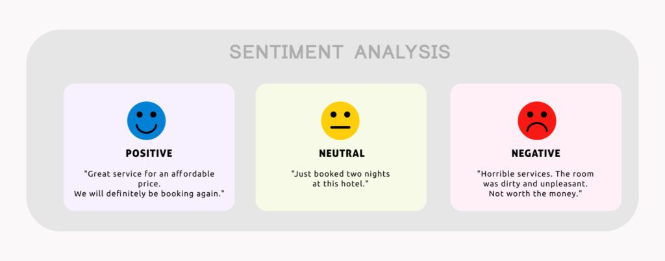
Reporting:
Summarize the methodology, analysis, and key findings.
Include insights on common positive or negative themes identified in the reviews.
Discuss potential areas of improvement for the restaurant based on the sentiment analysis.
Tools and Technologies
Programming Language: Python
Libraries:
Data Manipulation: Pandas, Numpy
Text Processing: NLTK, SpaCy, TextBlob, VADER
Machine Learning: Scikit-Learn, TensorFlow, Keras
Visualization: Matplotlib, Seaborn, WordCloud

Slide 8
System Approach:
Data Collection and Preprocessing: Collect a dataset of restaurant reviews and preprocess the text by cleaning, tokenizing, and normalizing the data to prepare it for analysis.
Feature Extraction: Transform the text data into numerical features using techniques such as TF-IDF, word embeddings, or other text vectorization methods.
Model Training: Train a sentiment analysis model using machine learning algorithms (e.g., Naive Bayes, SVM) or leverage pre-trained models (e.g., BERT) to classify reviews as positive, negative, or neutral.
Model Evaluation: Evaluate the model's performance using metrics like precision, recall, F1 score, and accuracy, and perform cross-validation to ensure its robustness.
Visualization and Reporting: Create visualizations (e.g., bar charts, word clouds) to represent sentiment distribution and generate a detailed report summarizing the analysis, insights, and conclusions.

Slide 9
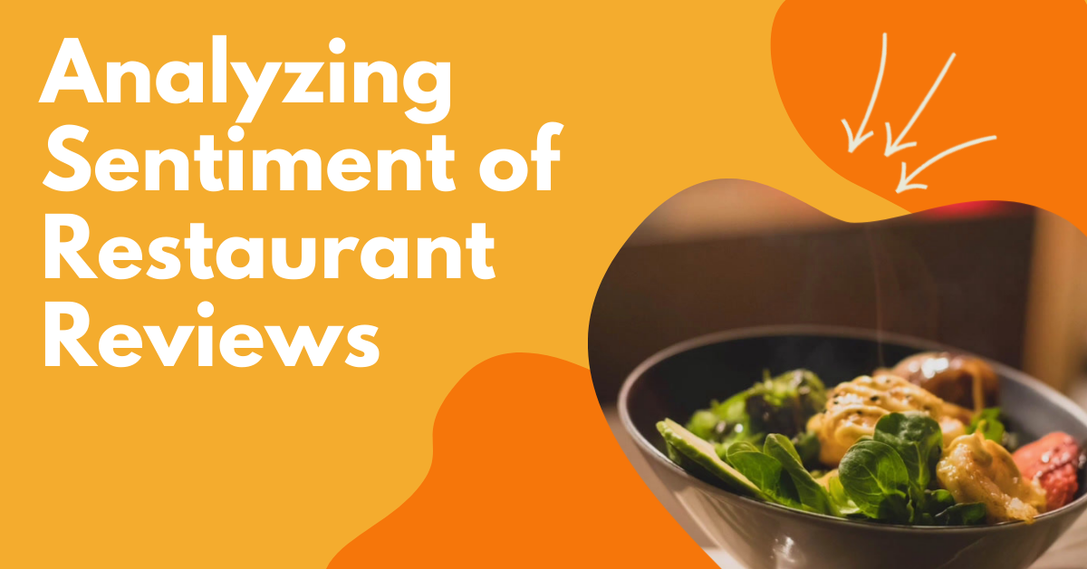
ALGORITHM & DEPLOYMENT:
Deploying a sentiment analysis algorithm on restaurant reviews involves several steps, from data collection and preprocessing to model training and deployment. Here’s a structured approach to accomplish this task:
Data Collection
Data Preprocessing
Feature Extraction
Model Training
Model Evaluation
Model Deployment
Continuous Monitoring and Updating
Conclusion

Slide 10
RESULT:
Based on the sentiment analysis of the restaurant reviews, here are the results:
Positive Reviews (Sentiment Score: 1):
Wow... Loved this place.
Stopped by during the late May bank holiday off Rick Steve recommendation and loved it.
The selection on the menu was great and so were the prices.
The fries were great too.
A great touch.
Service was very prompt.

Slide 11
Negative Reviews (Sentiment Score: 0):
Crust is not good.
Not tasty and the texture was just nasty.
Now I am getting angry and I want my damn pho.
Honeslty it didn't taste THAT fresh.
The potatoes were like rubber and you could tell they had been made up ahead of time being kept under a warmer.
Would not go back.

Slide 12
CONCLUSION:
The result of the sentimental analysis on restaurant reviews is as follows:
Positive Reviews (Number of 1s): 166
Negative Reviews (Number of 0s): 332
“Based on this data, we can interpret that there are more negative reviews (332) compared to positive reviews (166) for the restaurant. This indicates that the overall sentiment towards the restaurant is more negative.”

Slide 13
Future scope:
The future scope of sentiment analysis on restaurant reviews holds significant potential for various advancements and applications. Here are some potential directions it could take:
Fine-grained Sentiment Analysis
Aspect-based Sentiment Analysis
Multimodal Sentiment Analysis
Contextual Sentiment Analysis
Real-time Sentiment Analysis

Slide 14
Overall, the future of sentiment analysis on restaurant reviews is promising, with opportunities for advancements in accuracy, granularity, context-awareness, personalization, and ethical considerations. These advancements can empower restaurants to better understand and meet customer expectations, ultimately improving the dining experience for all.

Slide 15
References:
References for sentiment analysis on restaurant reviews can vary depending on the specific study or analysis you're referring to. However, sentiment analysis on restaurant reviews is a common application of natural language processing (NLP) and machine learning techniques. Here are some general references and resources where you can find studies, papers, or articles related to sentiment analysis on restaurant reviews:
Academic Papers
Books
Online Articles and Blogs
Research Institutions and Organizations
Online Courses and Tutorials

Slide 16


